Slide 1
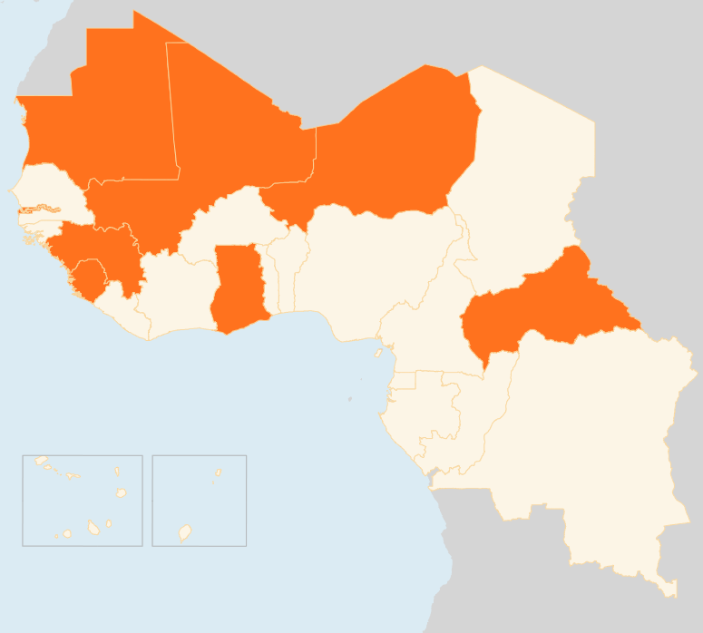

2 – 8 June 2015
CENTRAL AFRICAN REPUBLIC
NGOs SUSPEND OPERATIONS OVER INSECURITY
Several NGOs have temporarily suspended operations in the areas along Baboua-Besson and Baboua-Cantonnier roads in the western Nana Mambéré prefecture due to persistent insecurity posed by armed attackers. Movement on the Bouar-Cantonnier axis remains restricted. As a result of the insecurity, much of Nana Mambéré risks becoming inaccessible to humanitarian actors.
GHANA
150 KILLED BY BLAST, FLOODING
On 3 June, around 150 people were killed by an explosion at a petrol station in the capital Accra during torrential rains and heavy flooding that also caused deaths. The exact cause of the blast is yet to be ascertained, although some reports indicate that a fuel leak from the station mixed with flood waters and was ignited by fire in nearby houses. The flooding has affected a total of 9,255 people in the wider Accra region. The government announced that it would release US$ 14 million to help the victims.
MALI
20,500 CHILDREN OUT OF SCHOOL DUE TO VIOLENCE
The recent outbreak of violence in northern Mali has forced the closure of over 100 more schools, bringing to a total of 430 schools closed since January and 20,500 children deprived of education. The organisation of final examinations has also been disrupted for more than 1,300 students in Gao, Timbuktu, and Mopti regions as many examination centres are in insecure areas, posing protection concerns. Some 59,000 people have been displaced by the fighting involving government forces and armed groups. The total number of IDPs in Mali now stands at just over 100,000, mainly in the restive north.
MAURITANIA
AID GROUPS APPEAL FOR FUNDING
On 4 June, UNHCR and World Food programme warned that lack of funding is threatening assistance to Malian refugees in Mauritania. UNHCR and WFP have this year respectively received US$ 3.2 million and US$ 5.9 million, but still need US$ five million and US$ 3.9 million respectively to continue assisting the refugees over the next six months. Funding shortfalls prompted WFP to temporarily suspend distributions in March. It has now reduced rations for June - September and without additional funds, the distributions may come to a halt in October. Nearly 300 new arrivals from Mali have been registered in Mauritania since late April due to a flare up of fighting in northern Mali.
NIGER
MENINGITIS OUTBREAK EBBS
The meningitis outbreak that has killed 546 people and infected 8,259 others since January has peaked, the government and World Health Organization announced on 1 June. The outbreak peaked in the first week of May with 2,189 cases and 132 deaths reported. It began declining in the week of 11 - 17 May and continued to the last week of the month when 264 cases and eight deaths were recorded.
EVD GUINEA/SIERRA LEONE
19 NEW CASES REPORTED
From 4 - 7 June, Guinea reported seven new cases in the hotspot prefectures of Boké, Dubréka and Forécariah. Sierra Leone, meanwhile, recorded 12 cases in the five days to 7 June. Boké, Dubréka, Forécariah and Fria prefectures are currently the four EVD-active areas in Guinea, while in Sierra Leone, Ebola is now down to just three districts: in the capital, (Western Area Urban), Kambia, (near the border with Guinea) and in Port Loko.
MALI
MAURITANIA
20.5k
AID GROUPS APPEAL FOR FUNDS
OUT OF SCHOOL DUE TO VIOLENCE
NIGER
MENINGITIS OUTBREAKS DECLINES
CAR
NGOs SUSPEND WORK OVER INSECURITY
EVD GUINEA/ SIERRA LEONE
GHANA
NEW INFECTIONS
150
KILLED BY EXPLOSION, FLOODS
19
Creation date: 8 June 2014
Map data sources: UNCS, DevInfo, OCHA.
The boundaries and names shown and the designations used on this map do not imply official endorsement or acceptance by the United Nations

